Slide 1
Error messages Picoscope

Slide 2
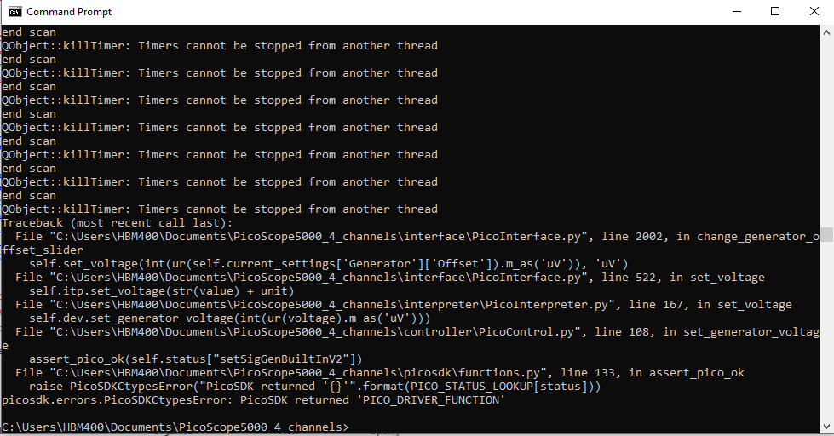
2020-09-23, after press stop during Voltage scan

